Slide 1
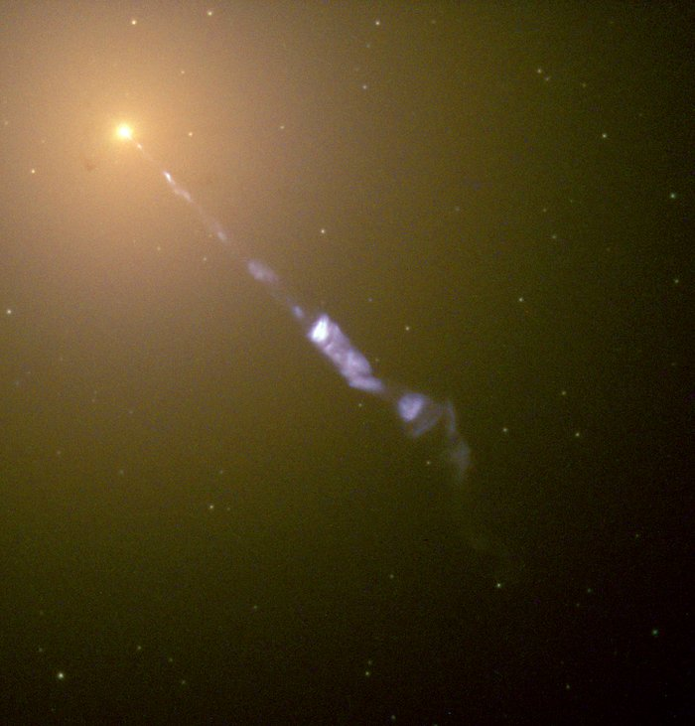



Investigating Supermassive Black Holes and Their Variability Using Structure Functions
By Derek Blue
Co-Supervised by Dr. Tina Harriott and Dr. Luigi Gallo
Image Credit: http://hubblesite.org/image/968/news_release/2000-20

Slide 2
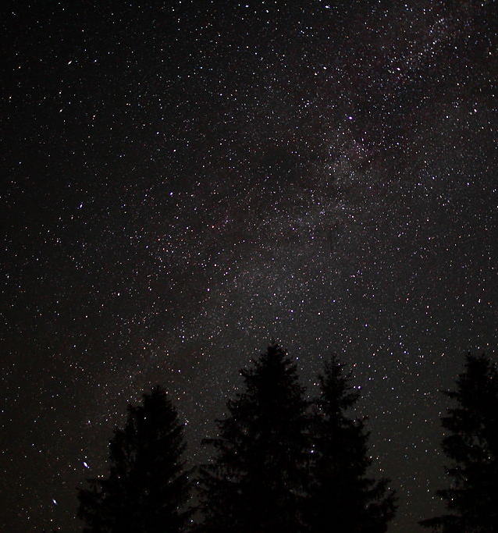
A brief introduction to space
This Photo by Unknown Author is licensed under CC BY-SA
Populated by Gas, Dust, and Stars
Collections of gas, dust, and stars called galaxies
Galaxies come in all shapes and sizes

Slide 3
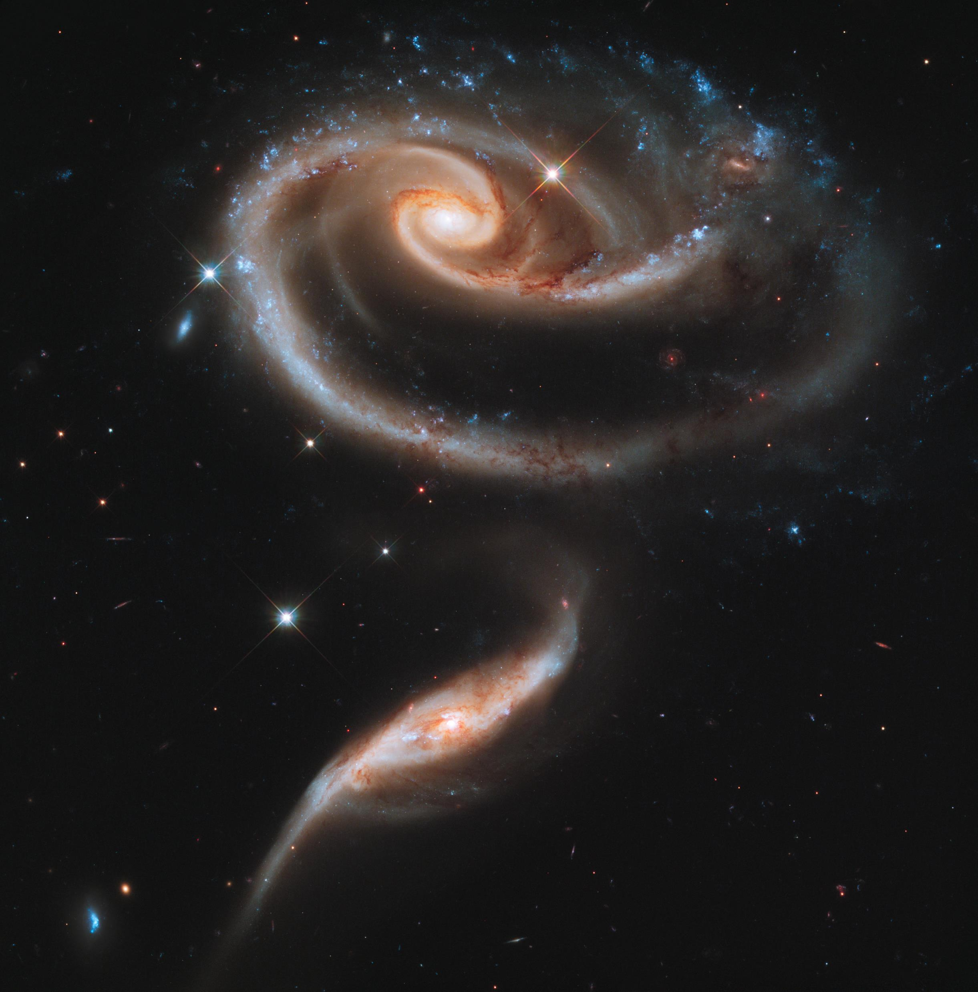
Relatively dim compared to stars
Originally described as “great clouds of stars”
Broken into three main groups
Galaxies
Image Credit: ESA/Hubble & NASA - https://www.spacetelescope.org/images/heic1107a/

Slide 4
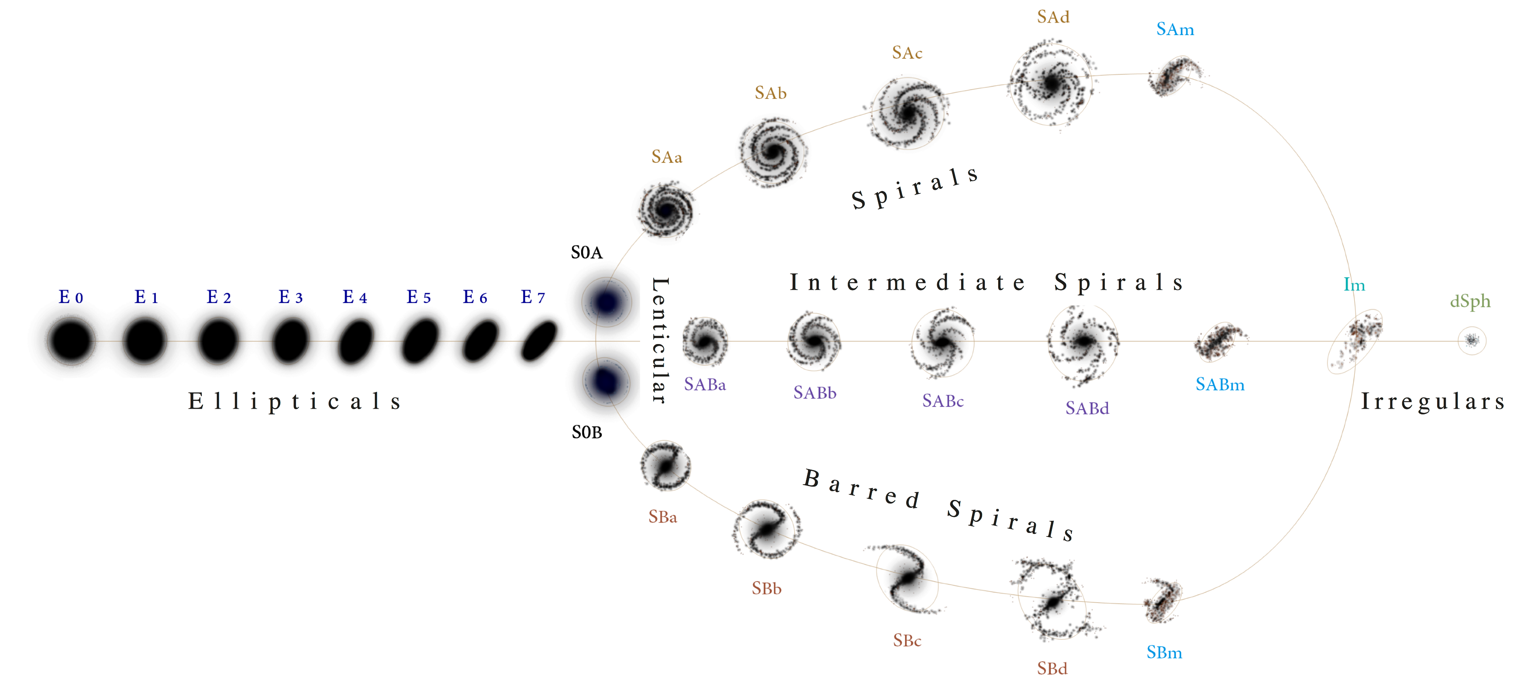
Galaxy Classification
Image Credit: https://commons.wikimedia.org/wiki/File:Hubble\_\_de\_Vaucouleurs\_Galaxy\_Morphology\_Diagram.png

Slide 5

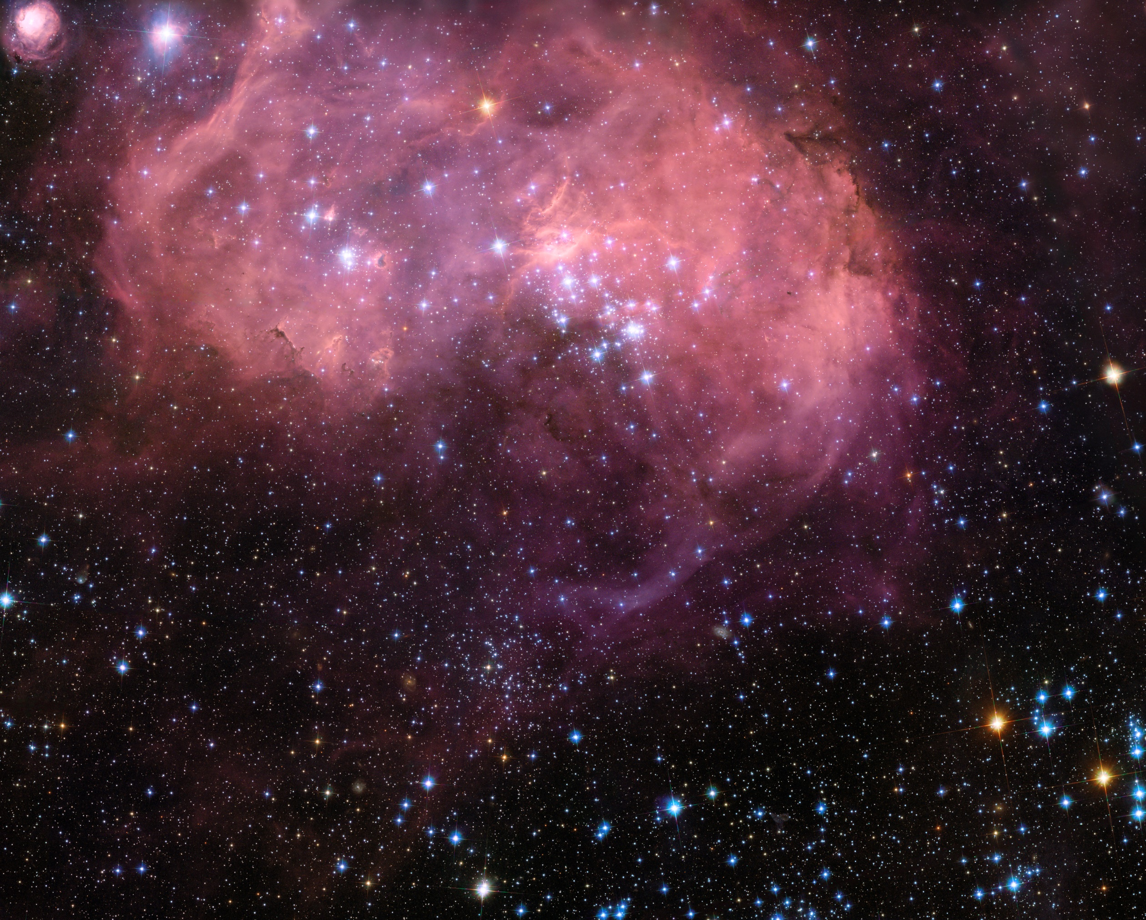
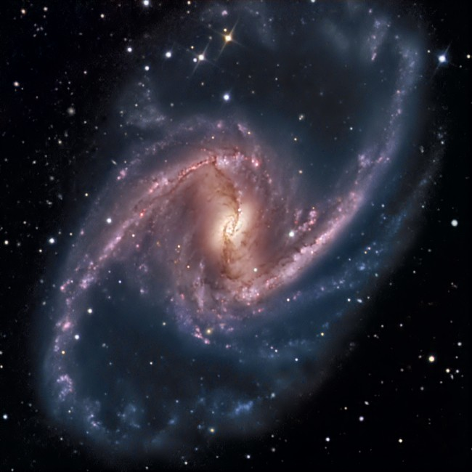
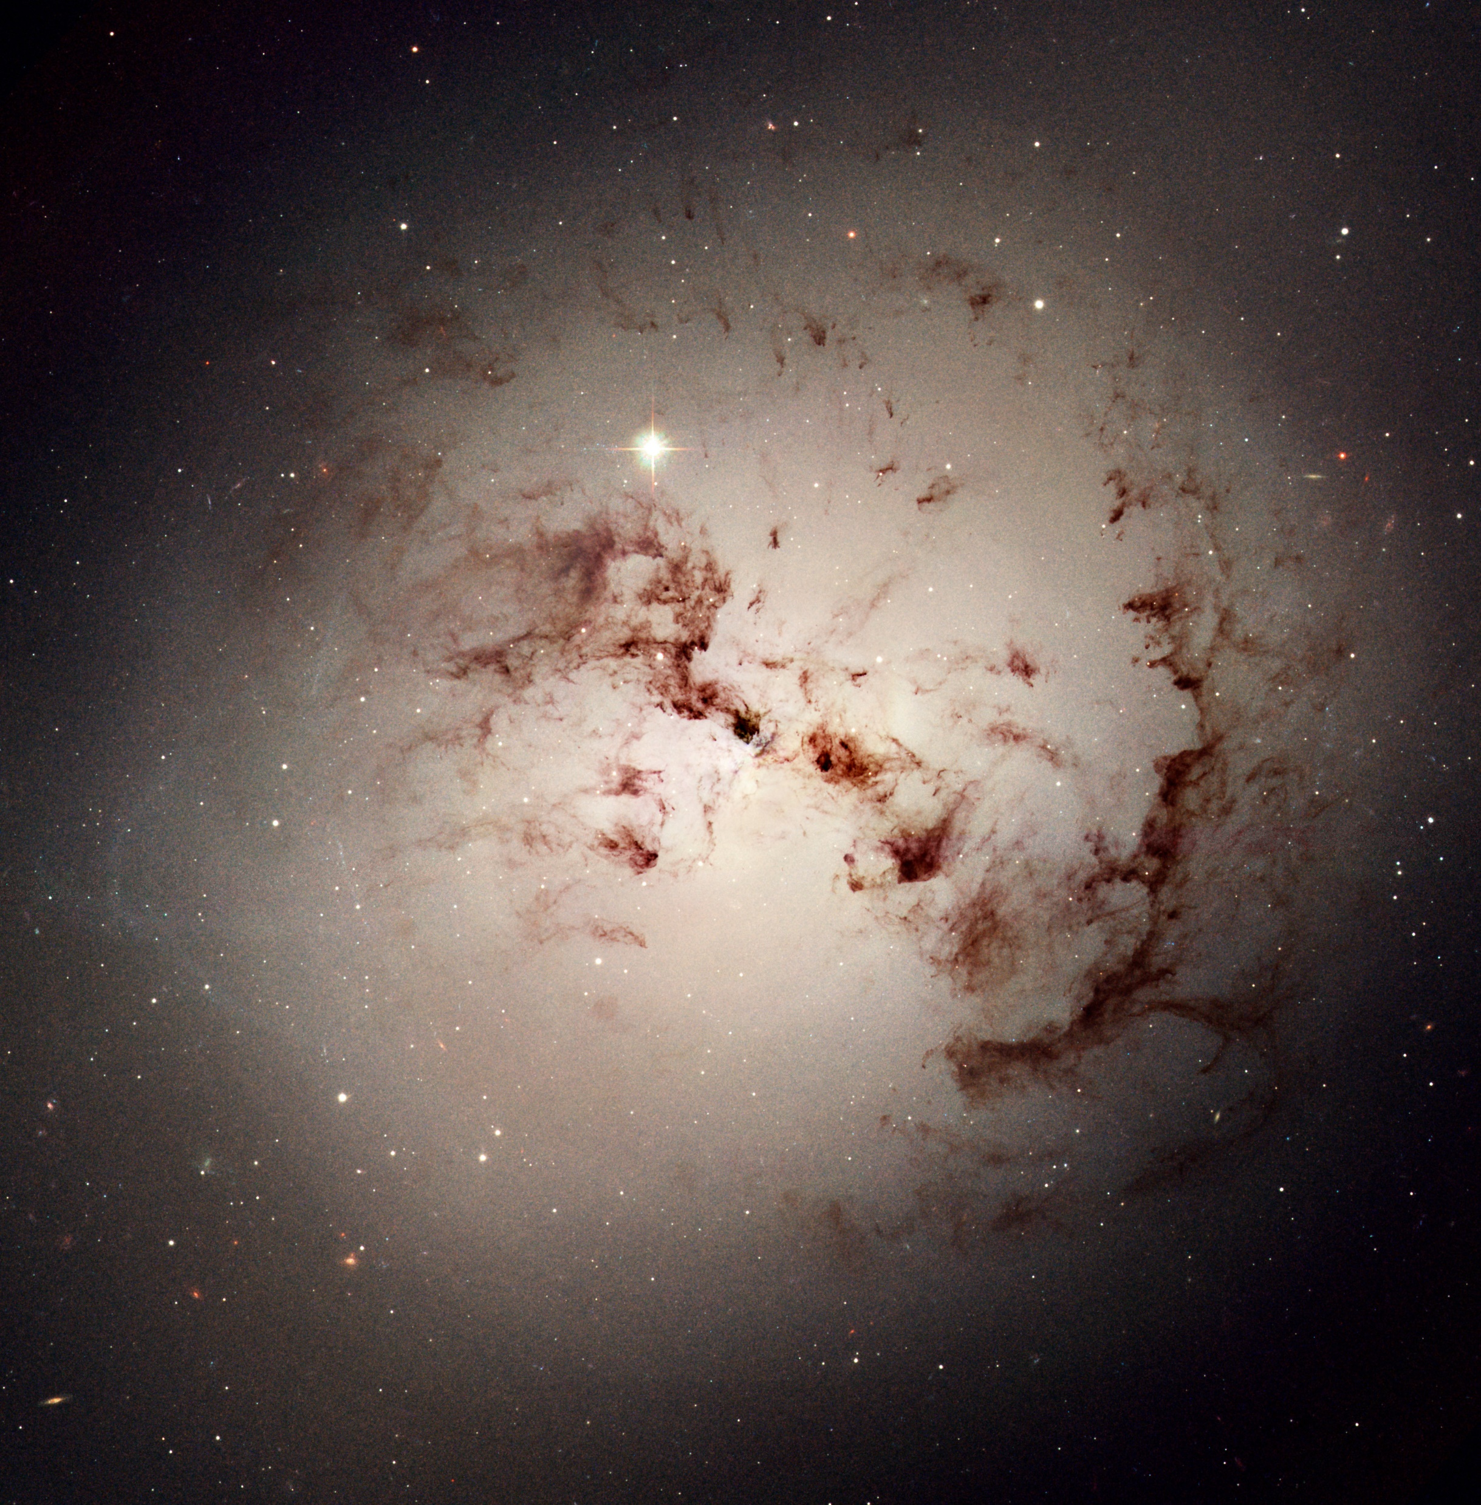
Galaxy Examples
Image Credits: ESA/Hubble & NASA - https://www.spacetelescope.org

Slide 6
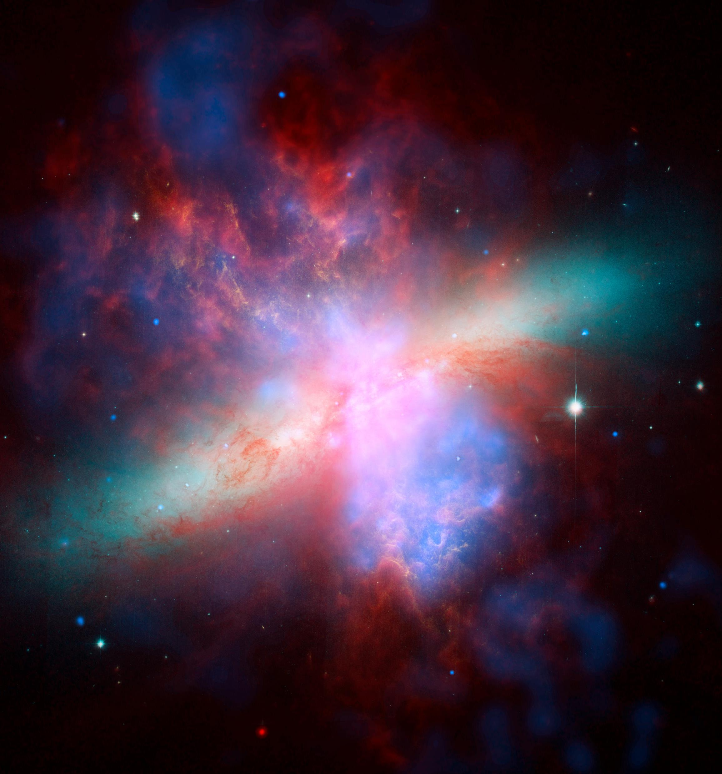
Image Credit: ESA/Hubble & NASA - https://www.spacetelescope.org/images/heic0604d/
Active Galaxies
Extremely bright centers
Hosts to supermassive black holes
Central black hole actively accreting
Highly variable spectra
Central engines called Active Galactic Nuclei (AGN)

Slide 7
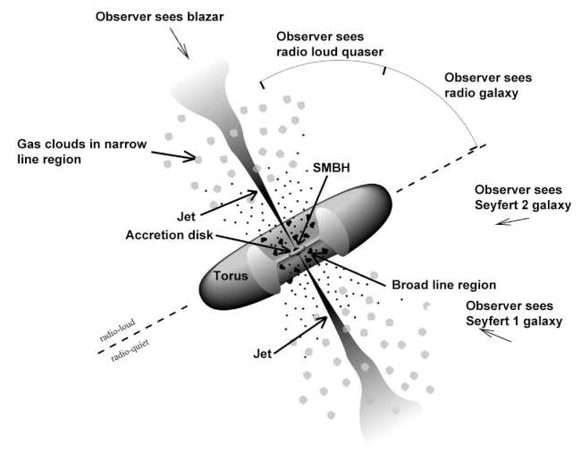
AGN brightness attributed to accretion
Viewing angle affects spectral energy distribution
Type of AGN determined by viewing angle
The Unified Model
Image Credit: https://fermi.gsfc.nasa.gov/science/eteu/agn/figure1.jpg

Slide 8

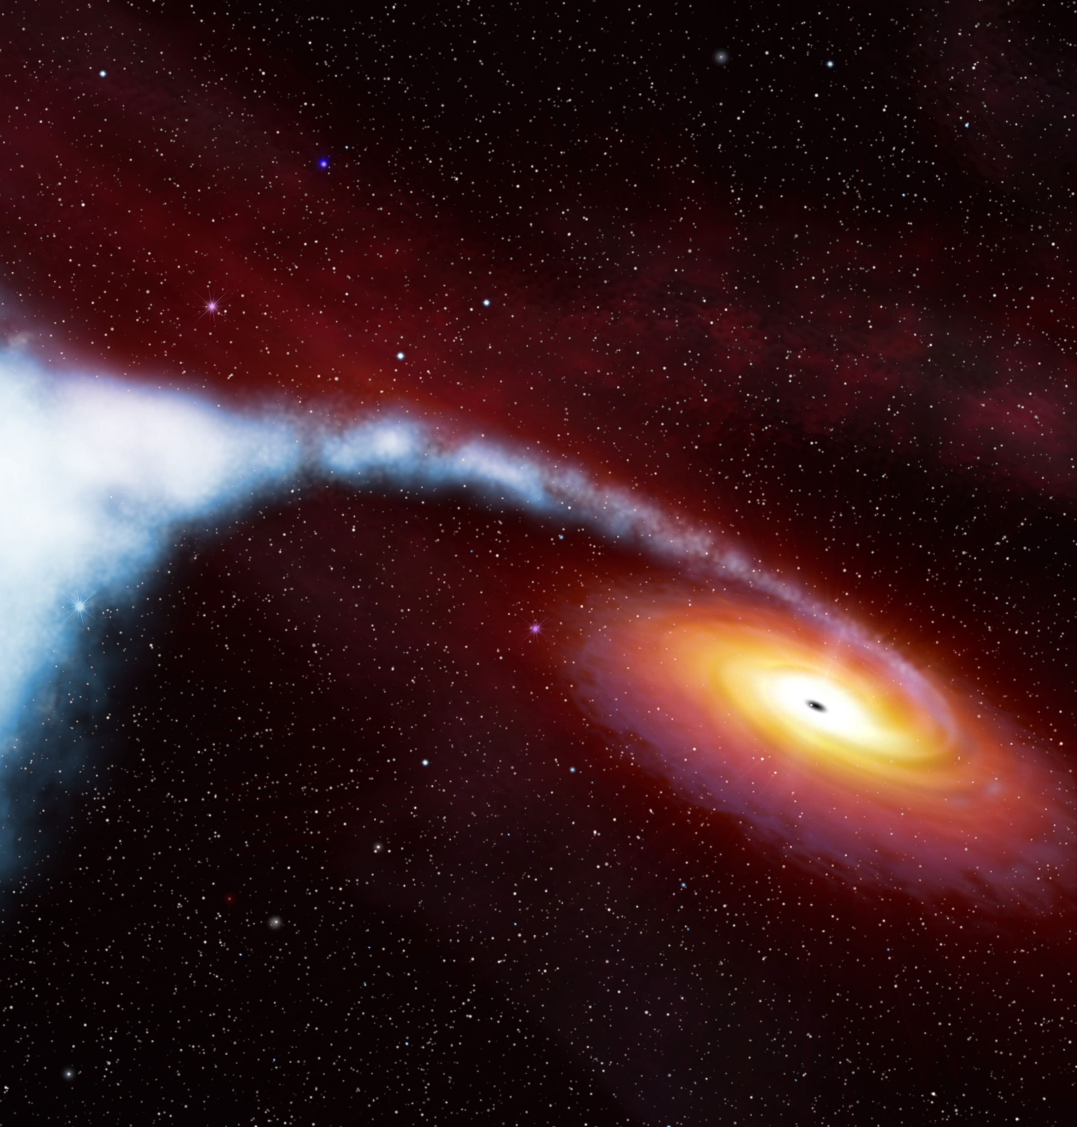
Black Holes
Extremely compact objects
Masses many times that of the Sun
So massive their gravitational wells affect light
Image Credit: ESA/Hubble & NASA - https://www.spacetelescope.org/images/cygx1\_illust\_orig/

Slide 9
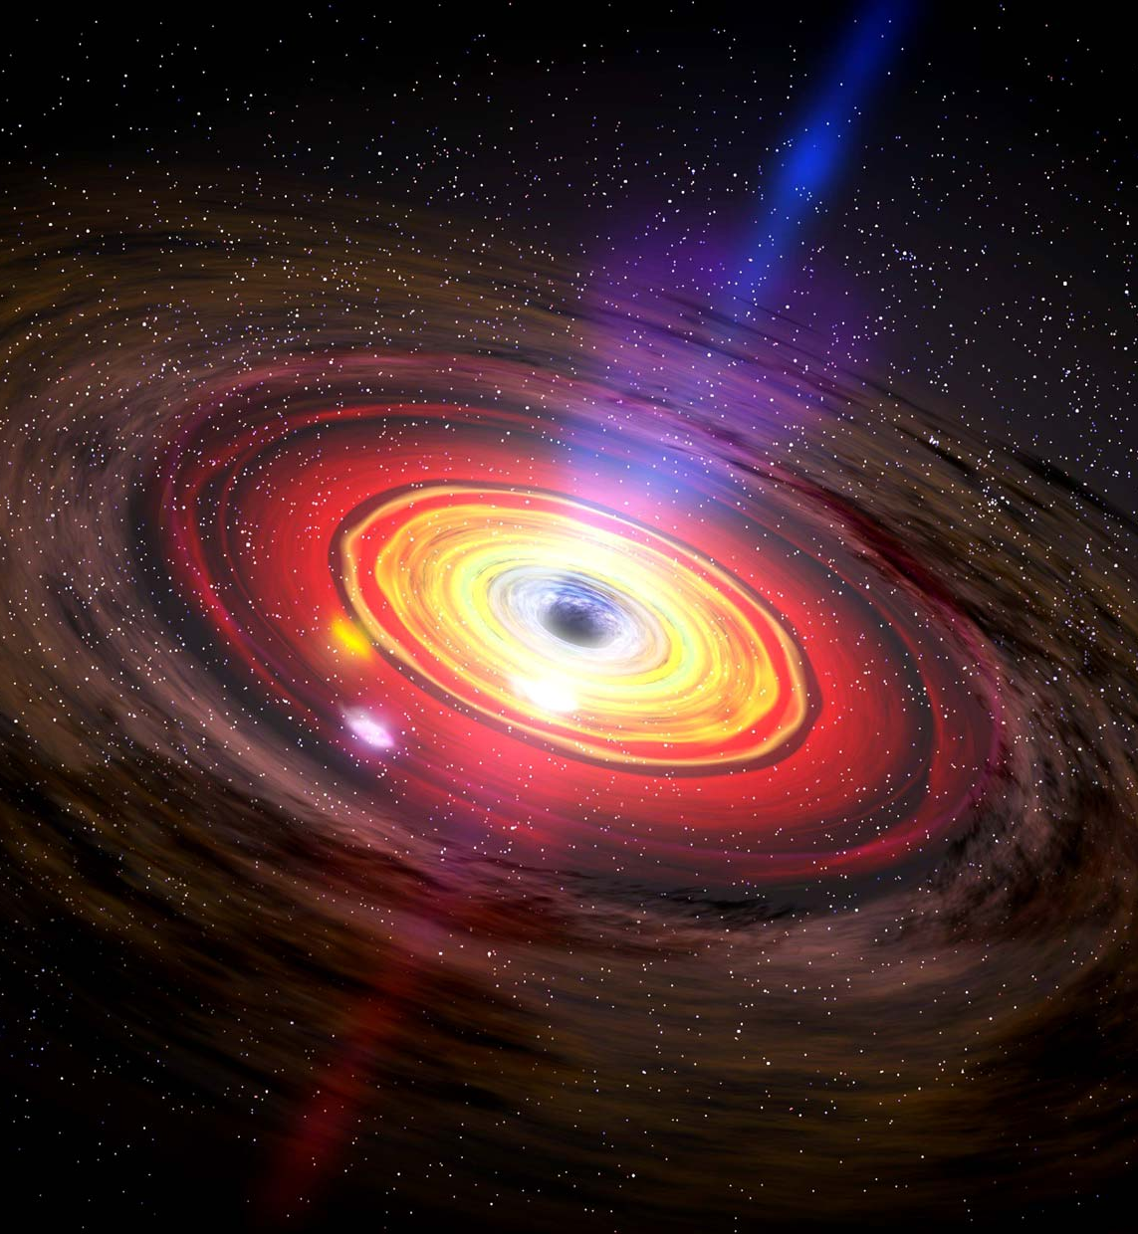

Types Of Black Holes
Determined by mass and activity
Stellar-Mass
$3−{10}^{2}M_{⨀}$
Intermediate-Mass
${10}^{2}−{10}^{5}M_{⨀}$
Supermassive
${10}^{5}M_{⨀}$ and larger
Image Credit: https://www.britannica.com/science/black-hole/media/67925/196036

Slide 10
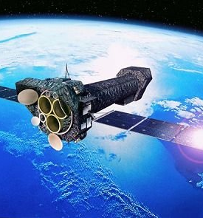
Image Credit: ESA https://www.esa.int/spaceinimages/Images/2000/11/XMM-Newton_artist_s_impression
How AGN are Observed
AGN are observed indirectly
The process of accretion causes large amounts of UV and X-ray emission
Satellite telescopes are used due to atmospheric absorption

Slide 11

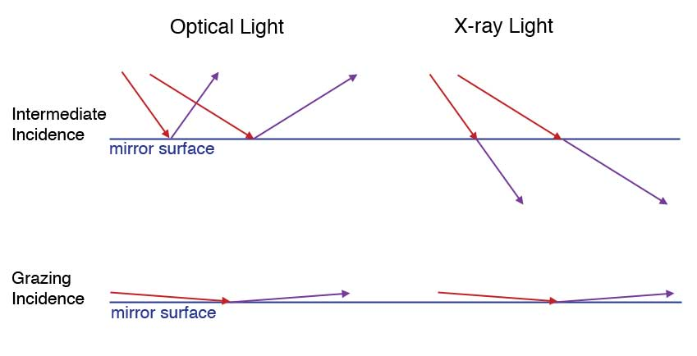
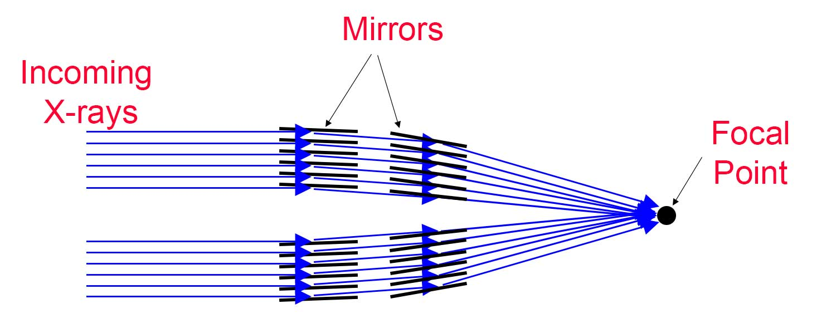
How AGN are Observed
X-rays cannot be captured like optical light
Process known as grazing incidence used
X-ray telescopes employ many mirrors

Slide 12
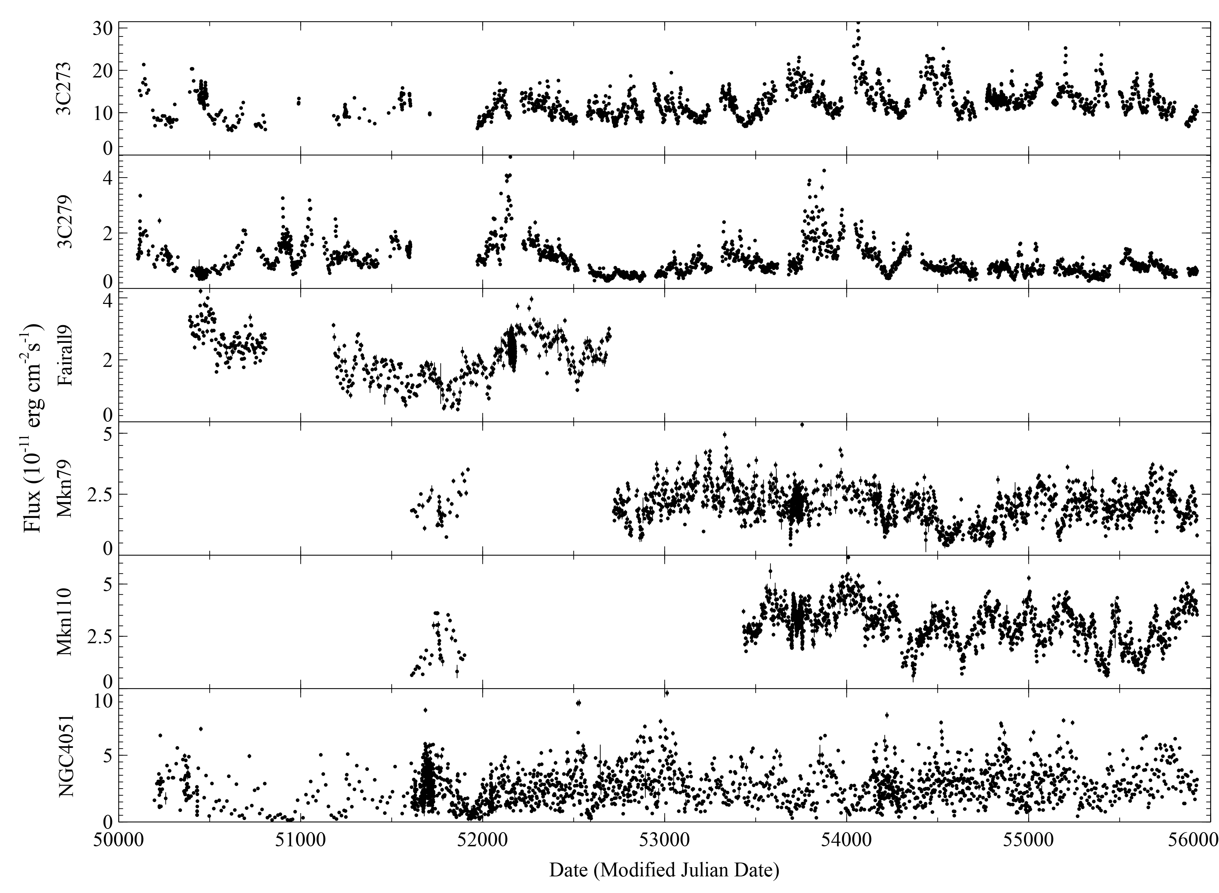
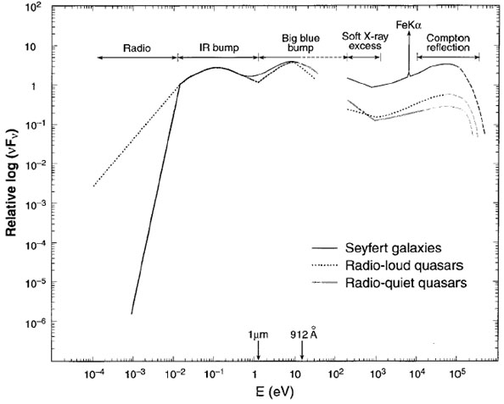
Data Collection
Relatively flat spectra
Telescopes record individual photon energy
Photon counts sorted by energy level

Slide 13
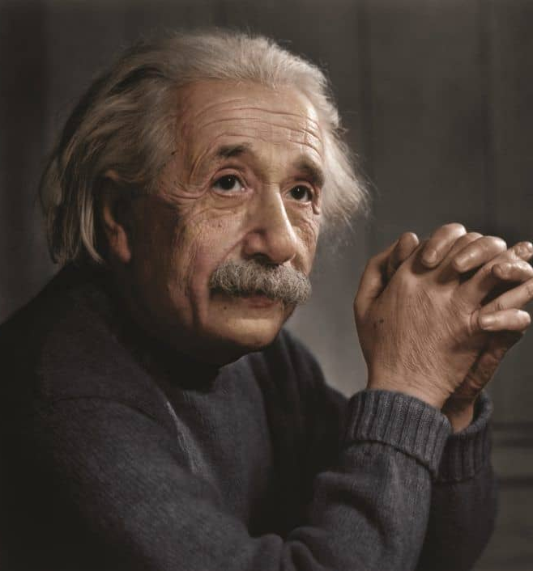
General Relativity
Used in determining properties of AGN
Predicts the paths light rays take in curved spacetime

